Slide 1
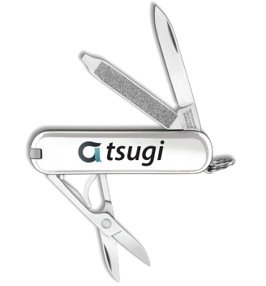
Koseu – LMS / LOR / MOOC Platform / App Store

Slide 2
Warning: If this freaks you out keep saying, "It is only an App Store"

Slide 3

TL;DR
Empower Indie publishers
Democratize MOOCs
Democratize LORs
Disaggregate LMS

Slide 4
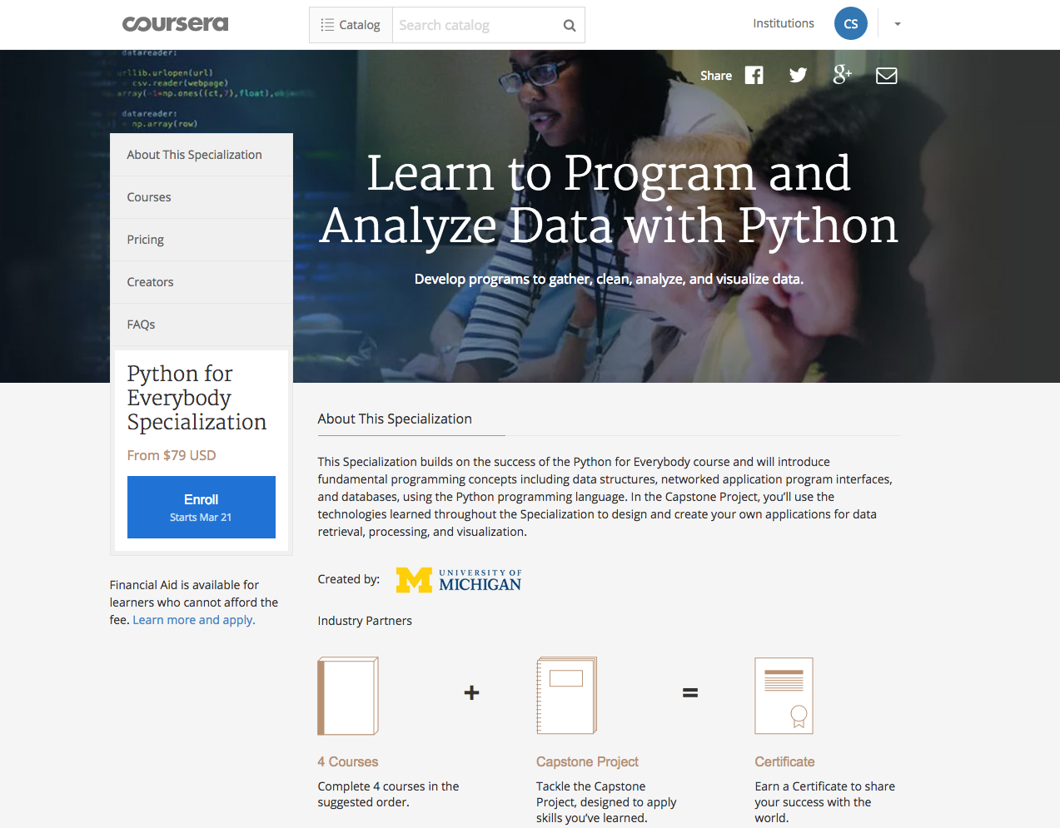

Slide 5
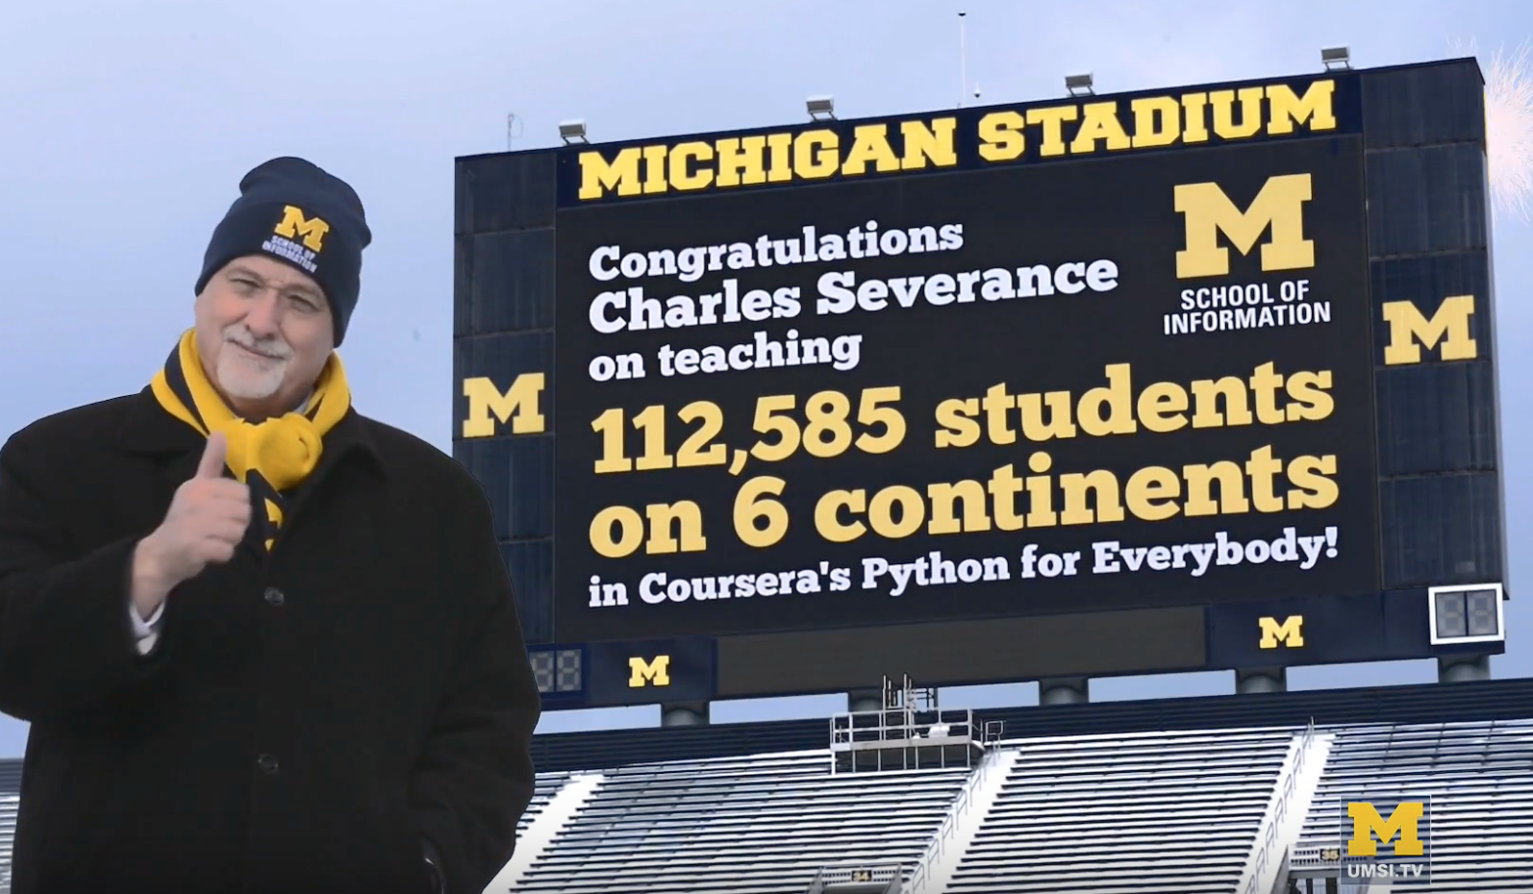
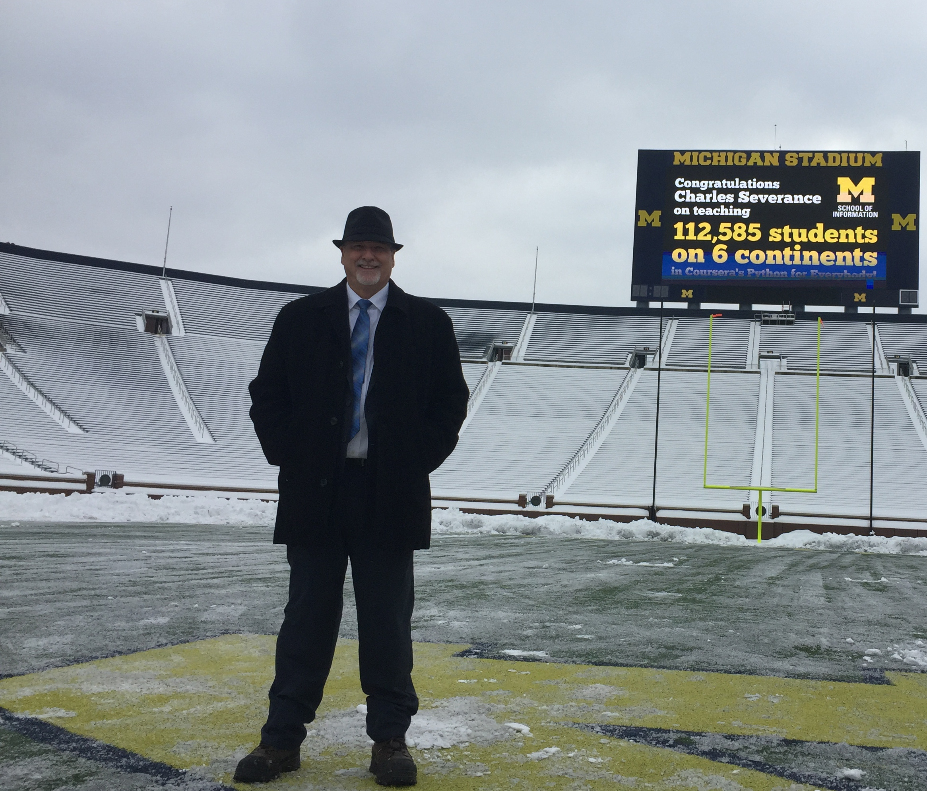
https://www.youtube.com/watch?v=ETGi75aE_OA

Slide 6

CONTENT ITEM®
CC®
LTI®
IMS CONTENT ITEM® FILLS THE GAPS AND MAKES CONNECTIONS BETWEEN IMS LEARNING TOOLS INTEROPERABILITY® AND IMS COMMON CARTRIDGE®.
LTI®, CC®, and Content Item® are trademarks of IMS Global Learning Consortium, Inc. (www.imsglobal.org)

Slide 7
CONTENT ITEM®
CC®
LTI®
FOR THE FIRST TIME IN THE HISTORY OF EDUCATIONAL TECHNOLOGY, YOU CAN MAKE AN APP STORE AND LEARNING OBJECT REPOSITORY WITHOUT PROPRIETATY EXTENSIONS.
LTI®, CC®, and Content Item® are trademarks of IMS Global Learning Consortium, Inc. (www.imsglobal.org)

Slide 8
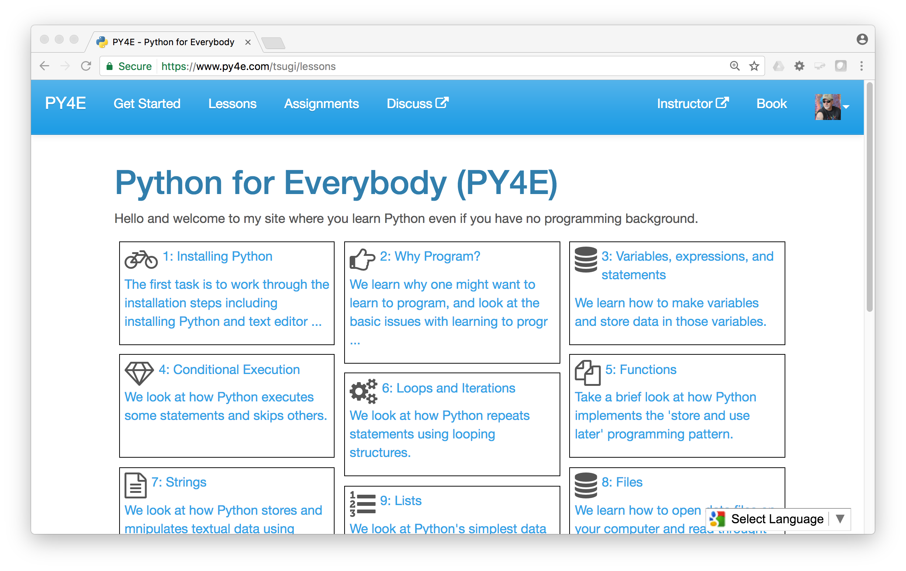
www.py4e.com (a.k.a. www.masteringpython.com)

Slide 9



CreateSpace
10
Pandoc
py4e.com
App Store (次)
OER Content (코스)
3K
github
1.2M
Coursera
Media
UM/Canvas
300
archive.org
Amazon
YouTube
ITunes
GooglePlay

Slide 10
TL;DR
Empower Indie publishers
Democratize MOOCs
Democratize LORs
Disaggregate LMS

Slide 11
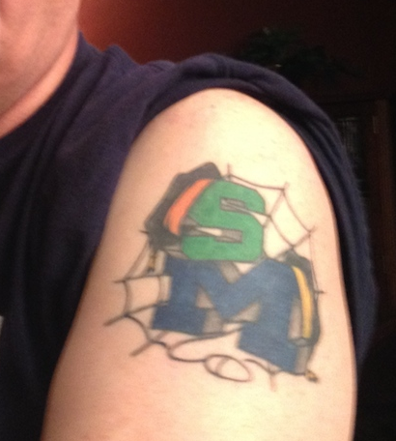
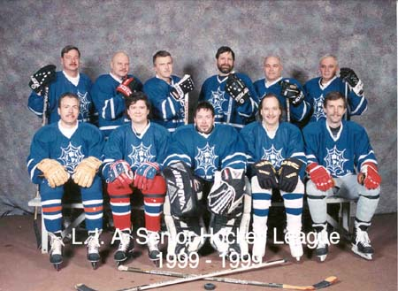

Slide 12
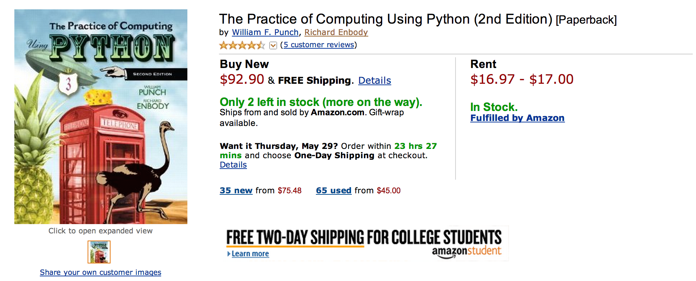

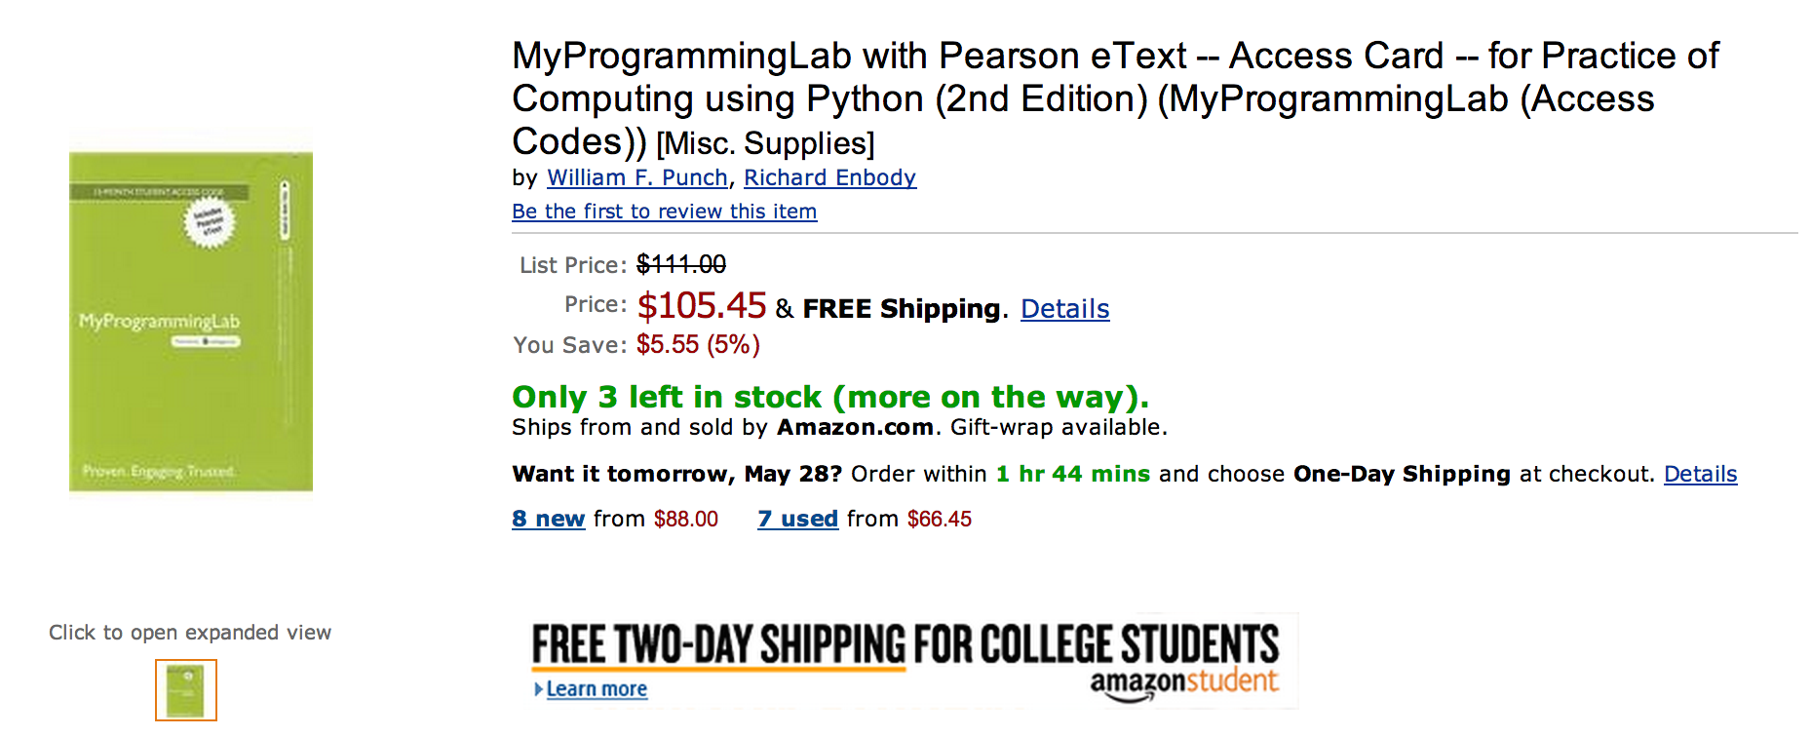

Slide 13
What does $198.35 get you?
Book
Automatic Homework Grading Software
Learning Management System Integration
Instructor Materials
Slides / Solutions Manual / Exams / Course Copy
Instructor Training
Notes:
$65 from Pearson $130 Form bookstore

Slide 14

Teacher Prep
Book
Pearson Value
Proposition
$200
Marketing
Software

Slide 15





Slide 16
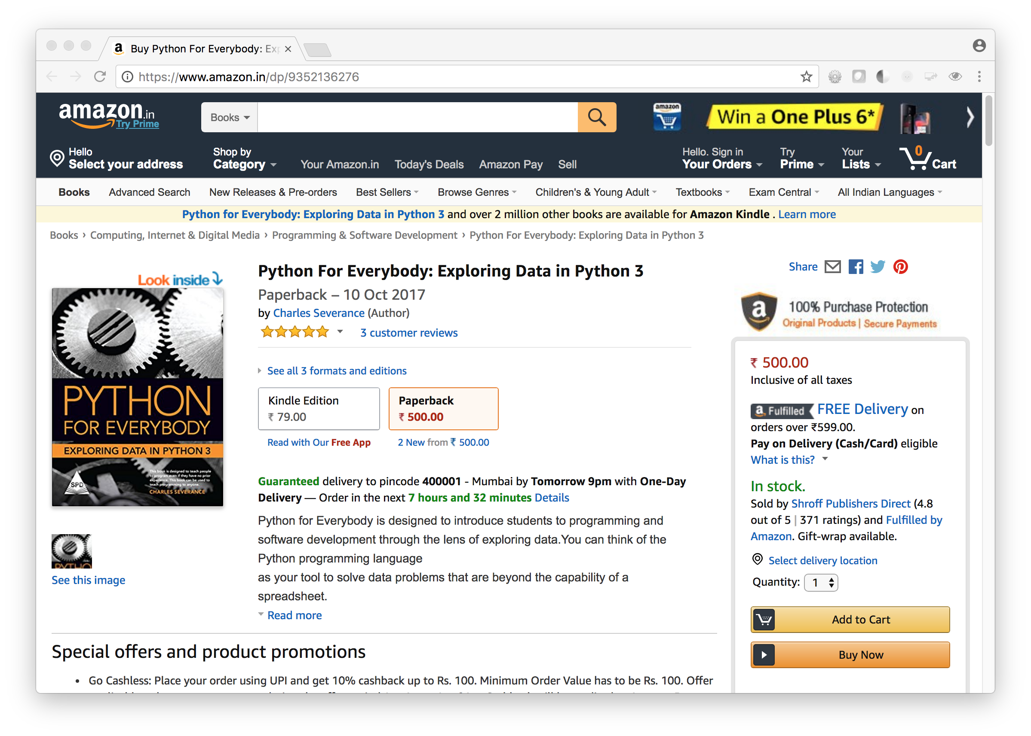
www.py4e.com/book

Slide 17
It is Fun to Be an OER Publisher
India
Shroff
DVD
Italy
Book – but might also do it.py4e.com
Korea
MOOC platform
Arabic
…

